Slide 1

Dr. Sajid Iqbal
Department of Computer Science
Bahauddin Zakariya University, Multan

Slide 2
Computer Programming
Decision statements

Slide 3
Reading Input Values
You can get input from program user
Python provides the input function for this purpose
The read data is in “string” data type
You need to convert it, if you want o have relevant number
x=input("Enter the value for x:") y=input("Enter the value of y:") print(x) print(y) print(x+y)
x=int(input("Enter the value for x:")) y=int(input("Enter the value of y:")) print(x) print(y) print(x+y)
Enter the value for x:10
Enter the value of y:20
10
20
1020
Enter the value for x:10
Enter the value of y:20
10
20
30

Slide 4

Exercises
Take four values from user and show its sum
Take four values from user and show them in reverse order
Let input is : $10,20,30,40$
Output should be: $40,30,20,10$
Take the four strings and print their concatenated output
Let input is: $Multan, Lahore, Sahiwal, Gujrat$
Output should be: $MultanLahoreSahiwalGujrat$
Take four strings from user and show them in reverse order
Let user input strings are: $Multan, Lahore, Sahiwal, Gujrat$
Output should be: $Gujrat, Sahiwal, Lahore, Multan$

Slide 5
Background
When solving a problem programmatically, you need to decide which code should run for a particular case
Decision making is programming languages is done using special key words known as Decision Constructs
Decision Constructs:
The key-words used to make decisions
If, if-else statements
Indentation: The way to write the statement by giving spaces in start
a=4 if a<5: print("a is smaller than 5") else: print("a is not smaller than 5")

Slide 6
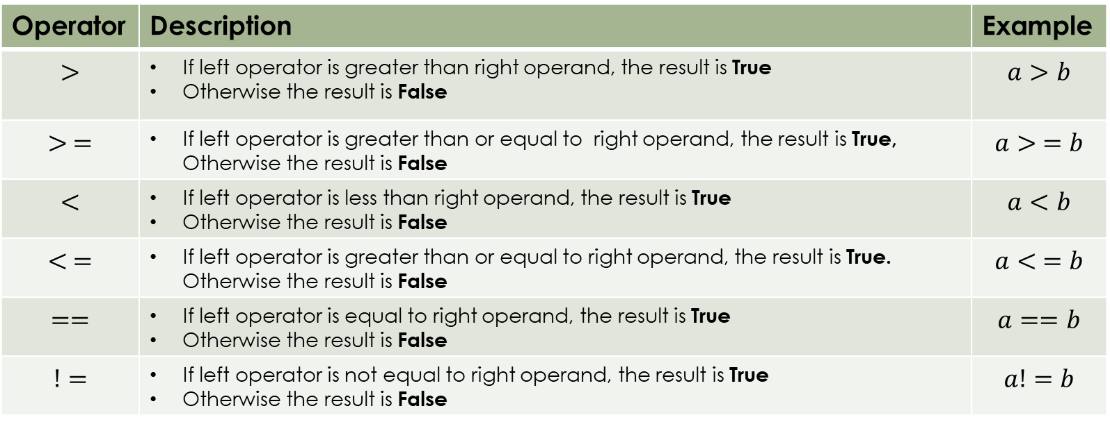
Relational Operators
Decision statements use relational operators to decide about the code to run
Python relational operators are binary operators
A binary operator requires two operands i.e. 5+6
The result of these operators is Boolean i.e. either True or False
Operator | Description | Example
$$>$$ | If left operator is greater than right operand, the result is True Otherwise the result is False | $$a>b$$
$$> =$$ | If left operator is greater than or equal to right operand, the result is True, Otherwise the result is False | $$a> =b$$
$$<$$ | If left operator is less than right operand, the result is True Otherwise the result is False | $$a<b$$
$$< =$$ | If left operator is greater than or equal to right operand, the result is True. Otherwise the result is False | $$a< =b$$
$$==$$ | If left operator is equal to right operand, the result is True Otherwise the result is False | $$a==b$$
$$!=$$ | If left operator is not equal to right operand, the result is True Otherwise the result is False | $$a!=b$$

Slide 7

If-Statement
If statement is a decision statement in python
The way to write this statement is as follows
$if<operand1><relational operator><operand 2>:$
Example: $if a>b:$
Way to write a statement is also known as syntax of statement
Scope of if-statement
Scope defines that how many other instructions are in effect of if-statement
a=10 b=20 if a<10: print("a is less than b")
if a<b: print("a is less than b") print("this is after the if scope")
a=30 if a<b: print("a is not less than b") print("this is after the if scope")

Slide 8
if-statement Scope
a=10 if a<b: print("a is not less than b") print("second statement in if scope") print("this is after the if scope")
a=10 if a<b: print("a is not less than b") print("second statement in if scope") print("3rd statement in if scope") print("this is after the if scope")
a=30 if a<b: print("a is not less than b") print("second statement in if scope") print("this is after the if scope")
a=30 if a<b: print("a is not less than b") print("second statement in if scope") print("3rd statement in if scope") print("this is after the if scope")

Slide 9
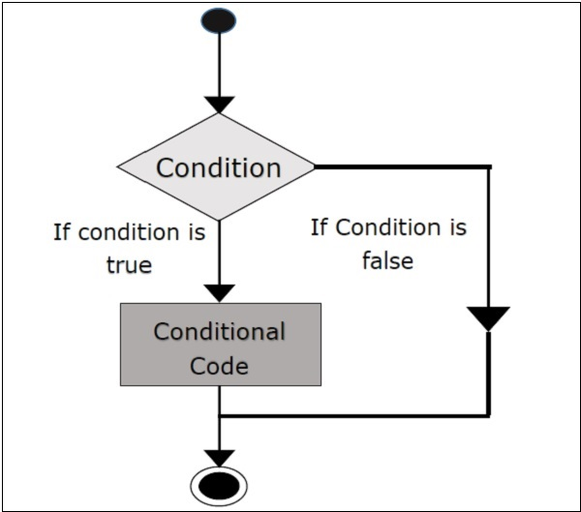
If-statement Flow Chart

Slide 10
if-statement Scope
if a<b:
a=10 if a<b: print("a is not less than b") print("second statement in if scope") print("this is after the if scope")
If condition is true
If condition is not true
print("a is not less than b") print("second statement in if scope")
print("this is after the if scope")

Slide 11
Practice Exercises
Draw the flow chart of followings
a=10 if a<b: print("a is not less than b") print("second statement in if scope") print("this is after the if scope")
a=10 if a<b: print("a is not less than b") print("second statement in if scope") print("3rd statement in if scope") print("this is after the if scope")
a=30 if a<b: print("a is not less than b") print("second statement in if scope") print("this is after the if scope")
a=30 if a<b: print("a is not less than b") print("second statement in if scope") print("3rd statement in if scope") print("this is after the if scope")

Slide 12
Multiple If statements
You can use multiple if-statements to make multiple decisions
Exercise: Draw the flow chart of this program
# Multiple if statements a,b=10,20 if a<15: print("a is less than 15") if b<25: print("b is less than 25")

Slide 13
If-Statement Exercises
Read three numbers from user.
If first number is 1, show the sum of other two numbers
If first number is 2, show the difference of other two numbers
If first number is 3, show the product of other two numbers
If first number is 4, show the division of other two numbers
Read three inputs from user.
If first number is “+”, show the sum of other two numbers
If first number is “-”, show the difference of other two numbers
If first number is “*”, show the product of other two numbers
If first number is “/”, show the division of other two numbers

Slide 14



Thanks for watching
Dr. Sajid Iqbal
Assistant Professor
Department of Computer Science
Bahauddin Zakariya University, Multan
sajidiqbal.pk@gmail.com
https://github.com/sajjo79/Introduction-to-Computers
Allah Hafiz
COMEDXD

